Slide 1
Uncontrolled copy not subject to amendment
Basic Navigation Using Map and Compass

Slide 2
Basic Navigation Using Map and Compass
Learning Outcome 3:
Be able to use a lightweight compass for practical navigation

Slide 3
The Compass
There are a variety of different compass styles
This a Silva compass

Slide 4
The Compass
They were originally discovered by the Chinese 5000 years ago.
They are made in a variety of forms for use on land, above and below the sea and in the air.
Examples of activities in which they are used are:
Hill walking - Mountaineering
Cycling - Surveying
Driving - Military
Sailing - Scuba Diving
Flying - Orienteering

Slide 5
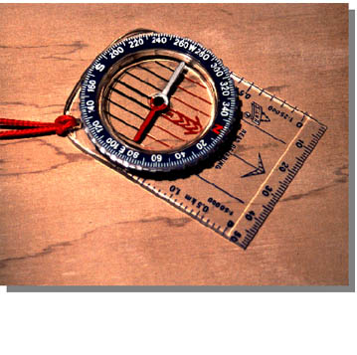
Parts of the Compass
The compass can be broken down into various components.
We will look at each component separately to define its use.
Silva Compass

Slide 6
Base Plate & Compass Housing
Compass Housing
The Base Plate is the mounting for the housing and displays a variety of information e.g.. Scale ruler.
The Compass Housing contains a magnetic bar, called the Needle and defines the points of the compass on a rotating bezel.
Base Plate
Silva Compass
Silva Compass

Slide 7
The Compass Needle
Needle
The needle is suspended in liquid which enables it to move freely, always settling with the red end pointing North.
Some needles are Luminous to help navigation in the dark.
Silva Compass

Slide 8
Direction of Travel Arrow
The Direction of Travel Arrow indicates the direction along which you wish to travel or take a bearing.
The arrow is fixed within the base plate.
The sides of the base plate run parallel to the arrow.
Direction of Travel Arrow
Silva Compass

Slide 9
The Index Line
The Index Line is a fixed line within the Compass Housing and is in line with the direction of travel arrow.
The Index Line marks the bearing you set by rotating the bezel.
Index Line
Silva Compass

Slide 10
Orienting Lines
These are displayed within the rotating Compass Housing and are designed to be aligned parallel with the Eastings on a map.
The orienting lines on some compass models show one half of the lines in red to depict north.
Orienting Lines
Silva Compass

Slide 11
Compass Scale
Nearly all compasses have a centimetre scale along the edge of the base plate to enable you to measure distances.
Used in conjunction with the scale at the bottom of the map, the compass scale enables you to calculate the distance on the ground.
Compass Scale
Silva Compass

Slide 12
Baseplate Compass

Slide 13
Cardinal Points (Compass Points)
North
0º & 360º
North West : 315º
North East : 45º
West
270º
90º
East
South West : 225º
South East : 135º
180º
South

Slide 14
Bearings are taken in degreesº- The cardinal points are divided up into 360º & measured clockwise
North
0º & 360º
North West : 315º
North East : 45º
West
270º
90º
East
South West : 225º
South East : 135º
180º
South

Slide 15
Magnetic Variation
True North
The difference in degrees between Magnetic (Mag) North and Grid North is referred to as the Magnetic Variation (usually 4º West in UK.)
Grid North
Magnetic North
5º

Slide 16
Map & Compass Work
Mag to Grid…………. GET RID
Grid to Mag………….ADD
(usually 4º West in UK)

Slide 17
Map & Compass Work
When working from the map we deal with Grid Bearings
When following a compass on the ground we work with Magnetic Bearings
There is a simple system which enables us to convert Grid to Mag and Mag to Grid
The system refers to whether we add or subtract the magnetic variation to convert the bearing

Slide 18
Points to Note
Stand clear of metal objects when using the compass. They will cause the needle to deviate and create inaccurate bearings. Objects as small as watches can make a difference.
Hold the compass as flat as possible to allow the needle to move freely.
Look after your compass - try to avoid dropping or knocking it.
Store away from other compasses and electrical equipment.
Your compass may need replacing if a large air bubble forms in the Compass Housing.

Slide 19
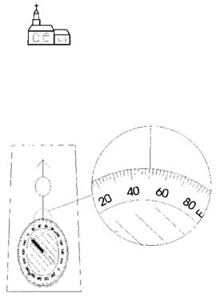
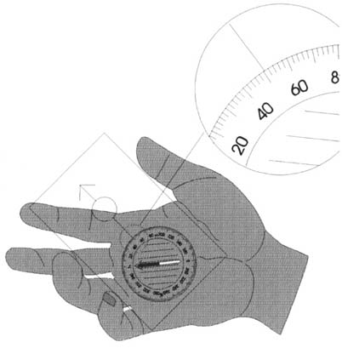
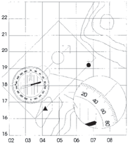
Setting a compass heading

Slide 20
Map to Ground
Grid to Mag………….ADD

Slide 21
Map to Ground
Select a start and finish point on the map.
Line up the edge of the compass with the line along which you intend to travel.
Keeping the base plate static - rotate the compass housing until the orienting lines are parallel with the Eastings and the red ‘N’ is pointing to North on your map.

Slide 22
Map to Ground
Read the bearing shown on the housing from the index line
Remember - Grid to Mag……Add
Add the magnetic variation shown at the top of the map (usually 4º West in UK)
You now have your magnetic bearing of the course you have chosen. The next step is to orientate yourself

Slide 23
Orientating
Hold your compass level and steady
Turn your body until the red end of the needle is in line with the Red ‘N’ on the Housing
The direction of travel arrow is now pointing along the route you chose from the map and you are ready to travel

Slide 24
Following the Compass Bearing
Hold your compass level and steady
Ensure that the red end of the needle is in line with the Red ‘N’ on the Housing every time you refer to the compass bearing
Follow the direction of travel arrow. You will find it easier to line up the direction arrow with a physical feature on the ground (e.g. tree, pylon, tower). Use this as a reference point which you can move towards. This is easier than following the compass every inch of the way

Slide 25
Map to Ground

Slide 26
Ground to Map
Mag to Grid…………. GET RID

Slide 27
Ground to Map
Select the feature on the ground to which you wish to take a bearing
Hold the compass steady and level
Point the direction of travel arrow at the feature
Rotate the housing until the red end of the needle is in line with the Red ‘N’ on the Housing

Slide 28
Ground to Map
This is your Mag bearing which you can either travel along or convert to a grid bearing.
To plot on the map you should first locate your own position and mark it.
Convert the Mag bearing to a Grid bearing by Mag to Grid……Get Rid. (Usually 4º West in UK.)
Subtract the magnetic variation.

Slide 29
Ground to Map
Place the compass on the map and keeping the bearing set on the housing, rotate the whole compass until the orienting lines are parallel to the Eastings on the map. The edge of the compass should run through your position and show the bearing on the map.

Slide 30
Ground to Map
By turning your body until the red end of the needle is in line with the Red ‘N’ on the Housing you have now oriented yourself and the map.

Slide 31
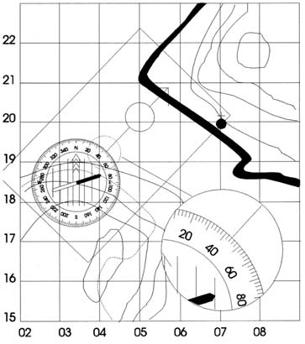
Ground to Map
Take a bearing - deduct the magnetic variation - rotate the compass to get the orienting lines parallel to the grid lines – you are somewhere on that line

Slide 32
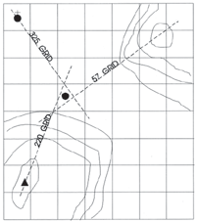
Resection
Now take 2 bearings from other features
Your position is the centre of the triangle

Slide 33
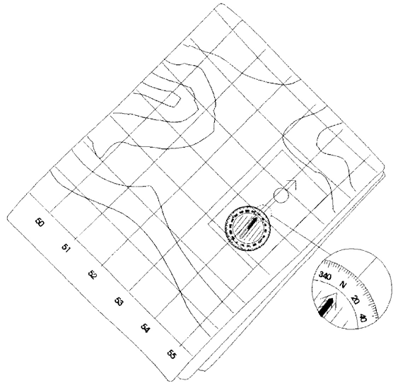
Setting the map with a compass

Slide 34
Quick Orientation
You can orientate yourself and the map to the ground at any time using this easy system:
A. Lay the compass on the map.
B. Line the edge of the compass and the orienting lines up with the Eastings.
C. Turn your body until the red end of the needle is in line with the Red ‘N’ on the Housing.
You and your map are now facing North.

Slide 35
Compass and map

Slide 36
Back bearing

Slide 37
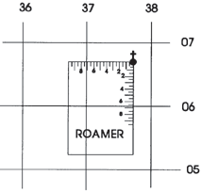
Scales and Roamer
Read the lowest number

Slide 38
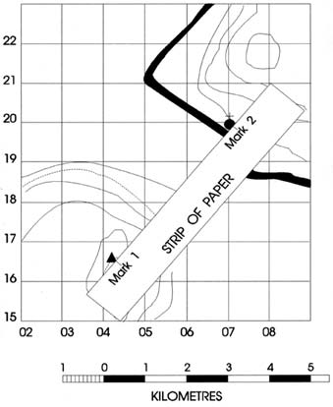
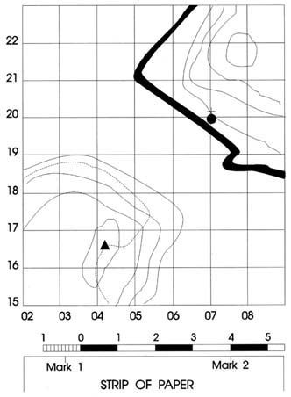
Measuring distances on a map
Mark the position of the 2 features
Place the straight edge of the paper against the scale and read off the distance

Slide 39
How GPS works

